Slide 1
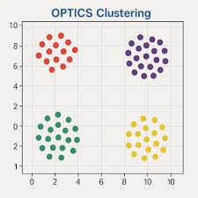
BIRCH Clustering
Balanced Iterative Reducing and Clustering using Hierarchies

Slide 2

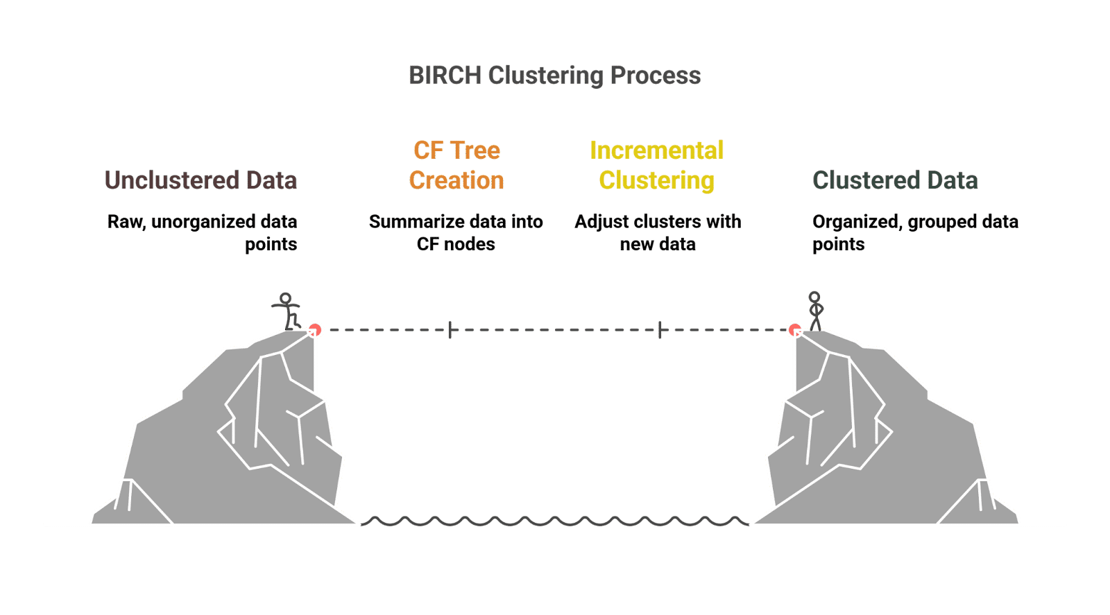
BIRCH CLUSTERING
It is a clustering algorithm designed to handle very large datasets efficiently.
Imagine, BIRCH as a tree that keeps summarizing data as it grows
When you have a huge dataset (millions of points), normal algorithms like K-Means or DBSCAN may take a long time.
BIRCH builds a tree structure (CF Tree = Clustering Feature Tree) that keeps only summarized information about the data.
Instead of storing every data point, it stores compact summaries (like group averages).
Once the tree is built, it can quickly form clusters.

Slide 3
Steps for Birch Clustering
Data comes in one by one – Instead of storing all customers in memory, BIRCH updates a summary tree as customers arrive.
Clustering Feature (CF) = (N, LS, SS)
N = Number of points
LS = Linear Sum (sum of data points)
SS = Square Sum These are used to calculate the cluster’s center and radius without storing all points.
Tree Building – BIRCH inserts each new data point into the closest leaf cluster in the tree. – If a leaf cluster becomes too big, it splits (like a branch growing new leaves).
Final Clustering – Once the CF Tree is built, you can apply another algorithm (like K-Means) on the summaries to refine clusters.

Slide 4
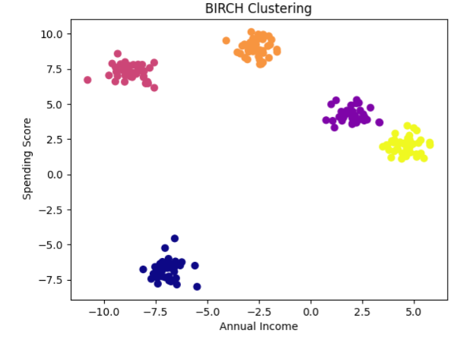
ADVANTAGES | DISADVANTAGES
Handle Large Datasets & Memory Efficient | Shape limitation
Fast Clustering | Sensitive to threshold
Incremental Learning | Not noise-resistant
Good Initialization | Not always accurate alone
Automatically Balances Clusters | Low dimensional only
PYTHON CODE
from sklearn.cluster import Birch
from sklearn.datasets import make_blobs
birch = Birch(n_clusters=5)
Y_birch = birch.fit_predict(X)

